Slide 1

Automotive Technology:
A Systems Approach, 8e
Chapter 19: Charging Systems
Rob Thompson and Jack Erjavec, Automotive Technology: A Systems Approach, 8th Edition. © 2025 Cengage. All Rights Reserved. May not be scanned, copied or duplicated, or posted to a publicly accessible website, in whole or in part.

Slide 2
Chapter Objectives (1 of 2)
19.01 Explain the purpose of the charging system.
19.02 Identify the major components of the charging system.
19.03 Explain the purposes of the major parts of an AC generator.
19.04 Explain half- and full-wave rectification and how they relate to AC generator operation.
19.05 Identify the different types of AC voltage regulators.

Slide 3
Chapter Objectives (2 of 2)
19.06 Describe the two types of stator windings.
19.07 Explain the features enabled by the use of a starter/generator unit.
19.08 Perform charging system inspection and testing procedures using electrical test equipment.
19.09 Explain how to replace an AC generator.

Slide 4
Charging Systems (1 of 2)
19.01 Explain the purpose of the charging system.
During cranking, the battery supplies all of the vehicle’s electrical power.
However, once the engine is running, the charging system is responsible for producing enough energy to meet the demands of the loads in the electrical system while also recharging the battery.
Several decades ago, the charging system depended on a DC generator.
The DC generator provided direct current (DC) and was similar to an electric motor in construction.
The biggest difference between a generator and a motor is the wiring to the armature. In a motor, the armature receives current from the battery.
This creates the magnetic field that opposes the magnetic fields in the motor’s coils, which causes the armature to rotate.
The armature in a DC generator is driven by the engine. It is not magnetized, and the windings simply rotate through the stationary magnetic field of the field windings, inducing a voltage in the conductors inside the armature.

Slide 5
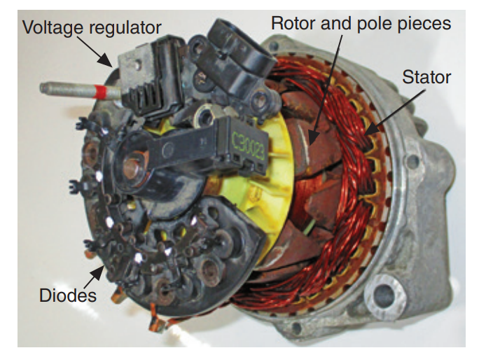
Charging Systems (2 of 2)
A motor can become a generator by allowing current to flow from the armature instead of to it.
In a DC generator, the placement of the brushes on the commutator changes the induced AC voltage to a DC voltage output.
DC generators had a very limited current output, especially at low speeds, and were replaced by AC generators.
AC generators are capable of providing high current output even at low engine speeds.
In an AC generator, a spinning magnetic field (called the rotor) rotates inside an assembly of stationary conductors (called the stator).
As the spinning north and south poles of the magnetic field pass the conductors, they induce a voltage that first flows in one direction and then in the opposite direction (AC voltage).

Slide 6
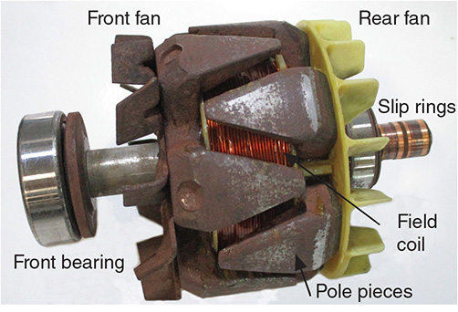
Alternating Current Charging Systems (1 of 5)
AC Generator Construction Rotor has the rotor assembly is a shaft with a coil and two pole pieces.
A pulley mounted on one end of the shaft allows the rotor to be spun by a belt driven by the engine.
The rotor is a rotating magnetic field inside the alternator.
The field coil is simply a long length of insulated wire wrapped around an iron core.
The core is located between the two sets of pole pieces.
As current flows through the coil, the core is magnetized and the pole pieces assume the magnetic polarity of the end of the core that they touch. Thus, one pole piece has a north polarity and the other has a south polarity.
The extensions of the pole pieces, known as fingers, form the actual magnetic poles.
A typical rotor has 14 poles, seven north and seven south.

Slide 7
Alternating Current Charging Systems (2 of 5)
Many late-model vehicles have generators equipped with an overrunning clutch pulley.
Overrunning alternator pulleys (OAPs), also called overrunning clutch pulleys, were developed to reduce the noise and vibrations caused by the conventional belt and pulley drive system for a generator (alternator).
With solid drive pulleys, changes in engine speed are absorbed by the drive belt and tensioning pulley.
This causes increased wear on both the belt and tensioner and causes excessive vibration in the belt drive system.
The use of an OAP allows the alternator to be driven normally and to coast when engine speed decreases.
This reduces the load on the drive belt and tensioner. Decoupling pulleys, also called alternator decoupler pulleys or overrunning alternator decoupler (OAD) pulleys, have an additional spring in addition to using a one-way clutch.
The spring allows the pulley to absorb torsional vibrations in the pulley and does not affect the speed of the driveshaft in the alternator.

Slide 8
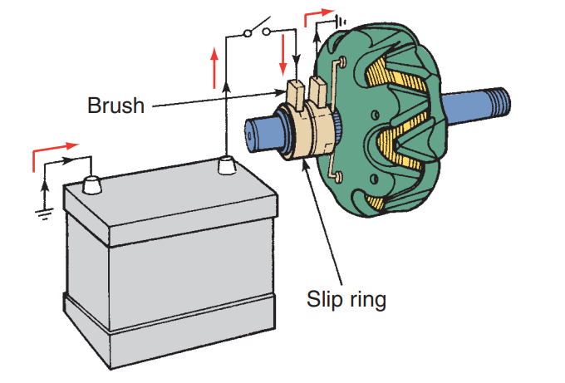
Alternating Current Charging Systems (3 of 5)
Slip Rings and Brushes
  The slip rings and brushes conduct current to the spinning rotor.
  Most AC generators have two slip rings mounted directly on the rotor shaft.
  They are insulated from the shaft and each other.
  Each end of the field coil connects to one of the slip rings.
  A carbon brush located on each slip ring carries the current to the field coil.

Slide 9
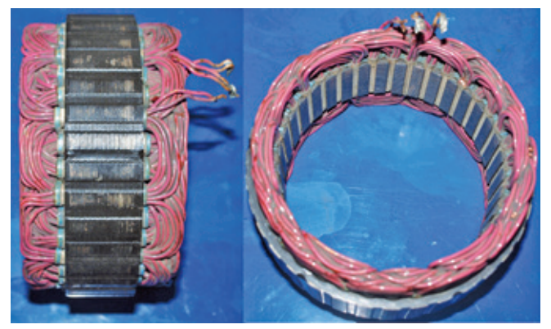
Alternating Current Charging Systems (4 of 5)
19.06 Describe the two types of stator windings.
The stator is the stationary member of the generator and is made up of a number of conductors, or wires, into which the voltage is induced.
Most AC generators use three windings to generate the required amperage output.
Each stator winding acts as an individual generator and produces one-third of the total generator output.
They can be arranged in either a delta configuration or a wye configuration (Figure 19–10).
Delta winding (Figure 19–11) received its name because its shape resembles the Greek letter delta, ∆.
The wye winding resembles the letter Y. Normally, a wye winding is used in applications in which high charging voltage at low engine speeds is required.

Slide 10
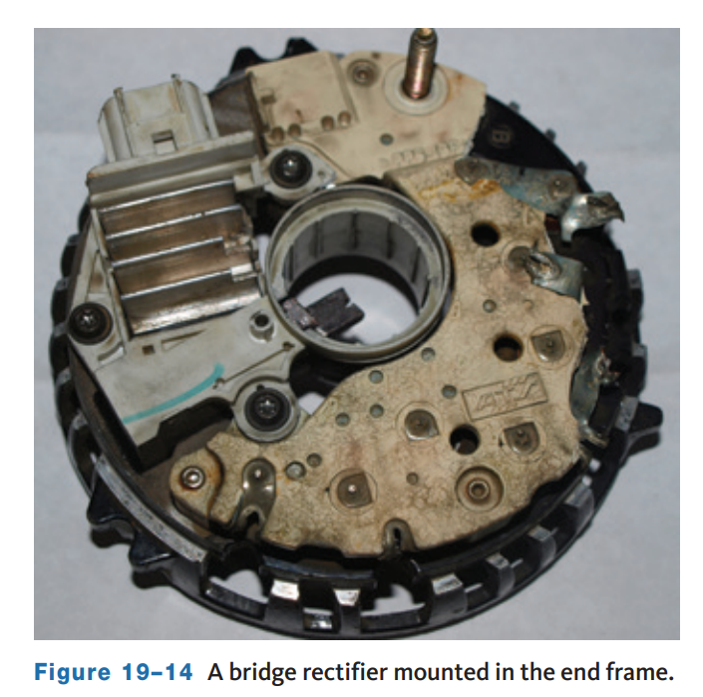
Alternating Current Charging Systems (5 of 5)
The end frame assembly, or housing, contains the bearings for the rotor shaft.
Each end frame also has built-in ducts so the air from the rotor shaft fan can pass through the AC generator.
Normally, a heat sink containing three positive rectifier diodes is attached to the rear end frame.
Heat can pass easily from these diodes to the moving air.
The housing may also contain the voltage regulator.
The end frames are bolted together and then bolted directly to the engine; therefore, the end frame assembly is part of the ground.
This means that anything connected to the housing that is not insulated from the housing is grounded.

Slide 11
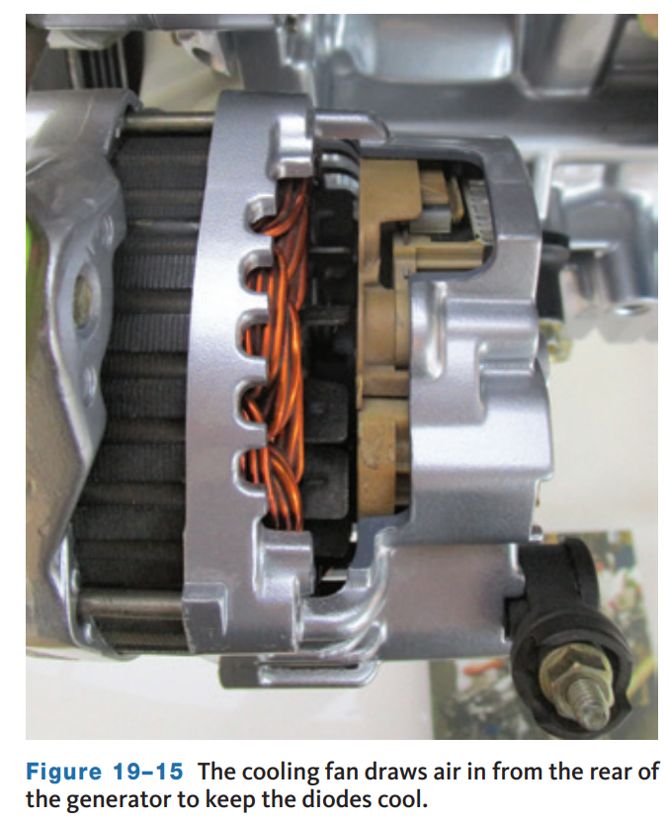
Cooling Fans
Behind the drive pulley on most AC generators is a cooling fan that rotates with the rotor.
This cooling fan draws air into the housing through the openings at the rear of the housing.
The air leaves through openings behind the cooling fan.
The moving air pulls heat from the diodes and their heat decreases.
Cooling the diodes is important for the efficiency and durability of an AC generator.
Several generator designs have been introduced recently that increase the cooling efficiency of a generator.
One of these is the AD-series generator from General Motors. The “A” stands for air cooled, and the “D” means dual fans.
This series is lighter than most other generators but capable of very high outputs.

Slide 12
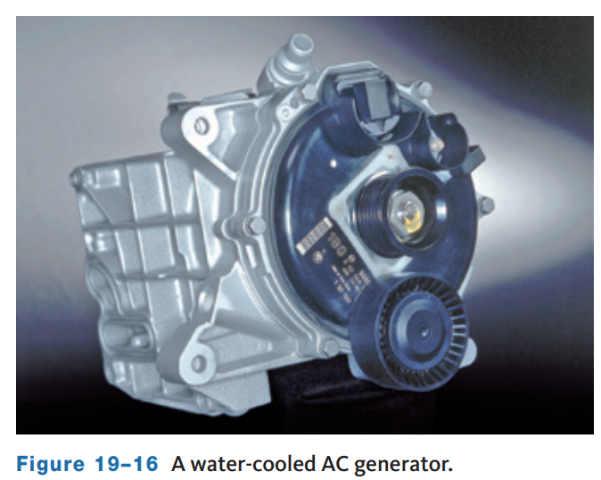
Liquid-Cooled Generators
Liquid-cool generators use water or coolant to cool a generator which is a very efficient way to keep the temperatures of the generator and its sensitive electronics down.
The primary reason for eliminating the fan and using liquid to cool the generator is to reduce noise. The rotating fan is a source of underhood noise that some automobile manufacturers want to eliminate.
Also at higher outputs, the rotating fan is a load on the engine as it moves the surrounding air.
These generators have water jackets cast into the housing. Hoses connect the housing to the engine’s cooling system.
Not only do these generators make less noise, they have higher power output and should last longer in the high-temperature environment of the engine compartment.

Slide 13
AC Generator Operation (1 of 3)
AC generators produce alternating current that must be converted, or rectified, to DC. This is accomplished by passing the AC through diodes.
A diode allows current to flow in one direction but not in the opposite direction.
Current flow is in the direction indicated by the triangle in its schematical drawing.
Therefore, it can function as a switch, acting as either conductor or insulator, depending on the direction of current flow.
In an AC generator, current is rectified (changed from AC to DC) through the use of diodes.
The diodes are arranged so that current can leave the generator in one direction only (as DC). A variation of the diode is the Zener diode.
This device functions like a standard diode until a certain voltage is reached.
When the voltage level reaches this point, the Zener diode allows current to flow in the reverse direction. Zener diodes are often used in electronic voltage regulators.

Slide 14
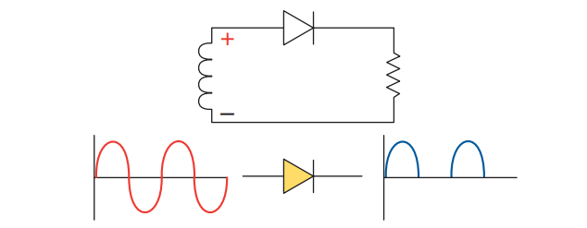
AC Generator Operation (2 of 3)
19.04 Explain half- and full-wave rectification and how they relate to AC generator operation.
DC rectification in the figure shows that when AC passes through a diode, the negative pulses are blocked off to produce the scope pattern shown.
Because it is wired so that the positive side of the diode is connected to the positive side of the load, the negative AC pulses are blocked.
If the diode is reversed, it blocks off current during the positive pulse and allows the negative pulse to flow.
Because only half of the AC current pulses (either the positive or the negative) is able to pass, this is called half-wave rectification.
By adding more diodes to the circuit, more of the AC is rectified.

Slide 15
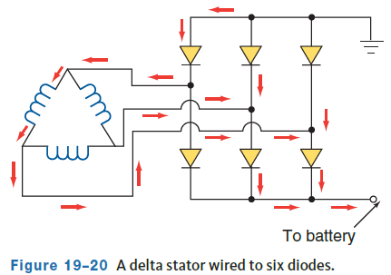
AC Generator Operation (3 of 3)
When all of the AC is rectified, full-wave rectification occurs.
Full-wave rectification requires another circuit with similar characteristics.
The figure shows a wye stator with two diodes attached to each winding.
One diode is insulated, or positive, and the other is grounded, or negative.
The center of the Y contains a common point for all windings.
It can have a connection attached to it. It is called the stator neutral junction.
At any time during the rotor movement, two windings are in series and the third coil is neutral and inactive.
As the rotor revolves, it energizes the different sets of windings in different directions.
The diode action does not change when the stator and diodes are wired in a delta pattern.

Slide 16
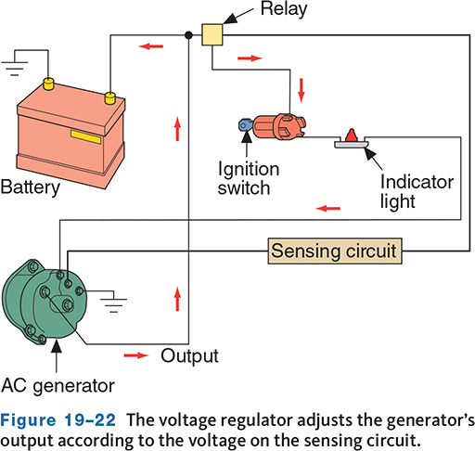
Voltage Regulation (1 of 4)
19.05 Identify the different types of AC voltage regulators.
Current is passed through the AC generator’s voltage regulator before it is applied to the winding.
The voltage regulator varies the amount of current supplied.
By controlling the amount of resistance in series with the field coil, control of the field current and voltage output is obtained.
Increasing field current through the rotor winding increases the strength of the magnetic field which increases AC generator voltage output.
The battery and the electrical system must be protected from this excessive voltage; therefore, charging systems use a voltage regulator to control the generator’s output.

Slide 17
Voltage Regulation (2 of 4)
A regulator controls field current and is connected in one of three ways to the rotor. These are called field circuits.
The A-circuit has the regulator on the ground side of the field coil.
  The battery feed (B+) for the field coil is picked up inside the AC generator. By placing the regulator on the ground side of the field coil, the regulator controls field current by varying the current flow to ground.
The second type of field circuit is the B-circuit.
  The voltage regulator controls the power side of the field circuit. The field coil is grounded inside the AC generator. Normally, the B-circuit regulator is mounted outside the generator.
The third type of field circuit is called the isolated field.
  This generator has two field wires attached to the outside of the case. One wire is the ground; the other is the B+. The voltage regulator can be placed on the ground or the B+ side of the circuit.

Slide 18
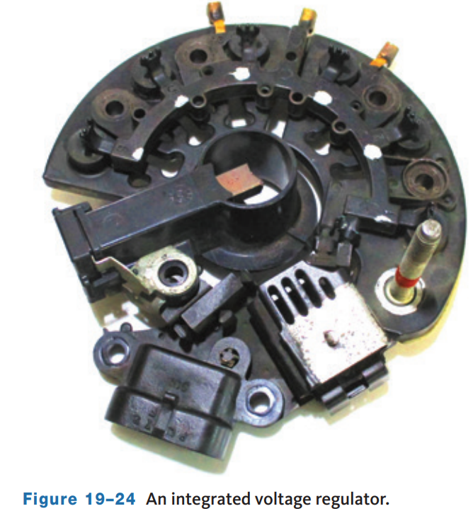
Voltage Regulation (3 of 4)
Electronic regulators can be mounted outside the generator or be an integral part of the AC generator.
Voltage output is controlled through the ground side of the field circuit (A-circuit control).
Most electronic regulators have a zener diode that blocks current flow until a specific voltage is obtained, at which point it allows the current to flow.
The schematic for an electronic voltage regulator with a zener diode is shown in Figure 19–25.
The generator’s output is controlled by pulse width modulation.
This varies the amount of time the field coil is energized in response to the vehicle’s needs.
Integrated circuit voltage regulators are used in many vehicles. These compact units are mounted either inside or on the back of the AC generator.

Slide 19
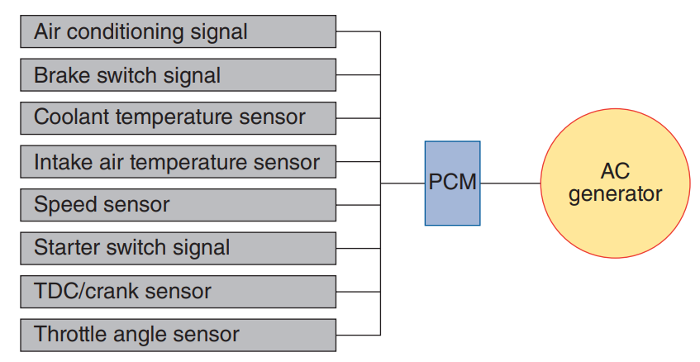
Voltage Regulation (4 of 4)
Computer Regulation: Some late-model vehicles do not have a separate voltage regulator.
Instead, voltage regulation is one of the many functions of the vehicle’s PCM.
The computer is used to control current to the field windings in the rotor.
The PCM looks at the input from several sensors in order to provide the correct charging output.
A significant feature of this system is its ability to vary the amount of voltage according to vehicle requirements and ambient temperatures.
This precise control allows the use of smaller, lighter storage batteries.
It also reduces the magnetic drag of the AC generator, increasing engine output by several horsepower.

Slide 20
Discussion
You have learned about charging systems beginning with DC generator and all the way through computer regulated AC generator designs.
Have a class discussion about the changes in the charging system over the years and why you suspect it has been evolving and redeveloping to the computer regulated AC generator. Do you see the trend? What do you think the driving forces are for this change over time?

Slide 21
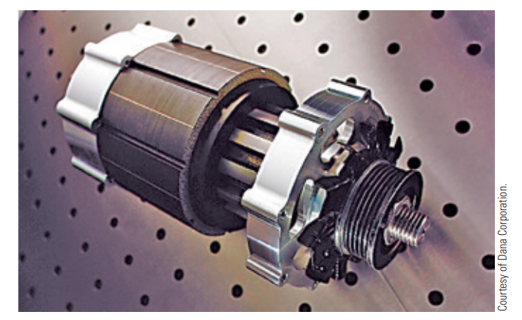
Current Trends (1 of 3)
Motor/Generators: Keep in mind that the main difference between a generator and a motor is that a motor has two magnetic fields that oppose each other, whereas a generator has one magnetic field and wires are moved through that field.
Using electronics to control the current to and from the battery, a generator can also work as a motor.
These units are called starter/generators or motor/generators.
A motor/generator can be mounted externally to the engine and connected to the crankshaft by a drive belt.
Motor/generators can also be directly mounted to the crankshaft between the engine and transmission or integrated into the flywheel.
The most common hybrid vehicles have two motor/generators: one that serves as the engine starting motor and a generator and the other as a traction motor and generator.

Slide 22
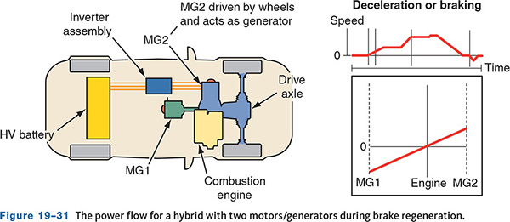
Current Trends (2 of 3)
Regenerative Braking: When the brakes are applied in a conventional vehicle, friction at the wheel brakes converts the vehicle’s kinetic energy into heat.
With regenerative braking, that energy is used to recharge the batteries. The vehicle’s kinetic energy is changed to electrical energy until the vehicle is stopped.
At that point, there is no kinetic energy. Through electronic controls, the motor/ generator functions as a generator.
The rotor is driven by the engine, which is driven by the vehicle’s wheels, as the vehicle is slowing down.
The amount of energy captured by regenerative braking depends on many things, such as the SOC of the battery and the speed at which the generator’s rotor is spinning.

Slide 23
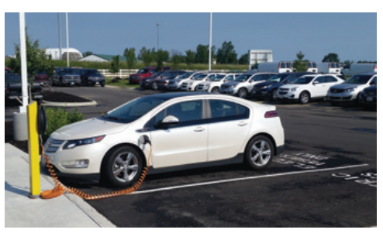
Current Trends (3 of 3)
Charging an electric vehicle (EV) or a plug-in hybrid electric vehicle (PHEV) requires a charging station.
As of early 2023, there are just under 50,000 listed public charging stations in the United States. Tesla currently owns and operates approximately 6,000 Supercharger stations across North America.
There are several types of charging in use, which are as follows:
  Level 1 charging uses a standard 120-volt household wall outlet. To fully charge a battery, it may take 8 to 12 hours or more depending on battery capacity.
  Level 2 charging requires 240-volt AC service. Charging may take 4 to 6 hours.
  Level 3 DC fast charging uses 480-volt DC chargers that can provide an 80 percent charge in 30 minutes.

Slide 24
Preliminary Checks (1 of 5)
Here are some of the following Safety Precautions:
  Disconnect the battery ground cable before removing any leads from the system. Do not reconnect the battery ground cable until all wiring connections have been made.
  Avoid contact with the AC generator output terminal. This terminal is hot (has voltage present) at all times when the battery cables are connected.
  The AC generator is not made to withstand a lot of force. Only the front housing is relatively strong.
  When adjusting belt tension, apply pressure only to the front housing to avoid damaging the stator and rectifier.
  Make sure all hair, clothing, and jewelry are kept away from moving parts.

Slide 25
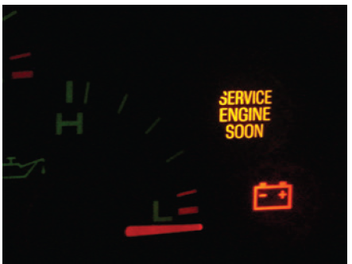
Preliminary Checks (2 of 5)
Part of all charging circuits is some sort of charging system warning device or indicator.
The sole purpose of these is to alert the driver when there is a problem.
They are also one of the first things to check when a charging system problem is suspected.
Vehicles have an indicator light, an ammeter, a voltmeter, and/or a message center in the instrument panel that allows the driver to monitor the charging system.

Slide 26
Preliminary Checks (3 of 5)
Indicator Light: This is the simplest and most common method of monitoring charging system performance.
When the system fails to supply sufficient current, the light turns on.
However, when the ignition switch is first activated, the light also comes on.
This is due to the fact that the AC generator is not providing power to the battery and other electrical circuits.
Once enough power is provided, the lamp should turn off.
If, when the engine is running, the electrical load is greater than what can be handled by the charging system, the indicator light should turn on.
This occasionally happens when the engine is idling. If there are no problems, the light should go out as the engine speed is increased. If it does not, either the AC generator or regulator is not working properly.
If the lamp does not light when the ignition is placed in the on position, check the bulb and its circuitry.

Slide 27
Preliminary Checks (4 of 5)
Meters: Some vehicles have an ammeter or voltmeter in their instrument cluster.
The voltmeter displays the voltage at the battery.
If the charging system is working fine, the voltmeter will read more than 12 volts. The ammeter monitors current flow in and out of the battery.
When the generator is delivering current to the battery, the ammeter shows a positive (+) indication.
When not enough current (or none at all) is being supplied, the result is a negative (−) indication.
The latter situation indicates a problem with the charging system.

Slide 28
Preliminary Checks (5 of 5)
Warning messages are typically found on vehicles with a PCM-controlled charging system.
Like other warning lamp circuits, the lamp, along with a message, should be displayed when the ignition is first turned on, but it should also turn off or clear once the engine is running, normally about 3 seconds.
If the lamp and/or message remains on, the charging system needs to be diagnosed. If the lamp does not initially illuminate, that circuit needs to be diagnosed.
Normally, the message center will display one of two messages when there is a faulty charging system:
  “Battery Not Charging Service Charging System.”
  “Service Battery Charging System.”
Both of these messages will set a diagnostic trouble code that can be retrieved to help in diagnosis.

Slide 29
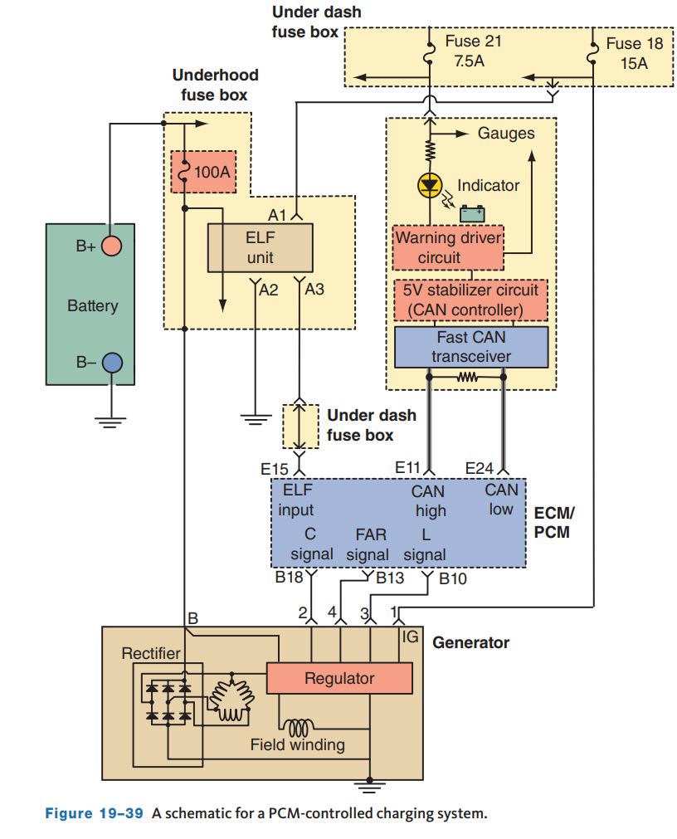
PCM-Controlled Systems
With PCM-controlled systems, diagnosis should continue with a check for diagnostic trouble codes (DTCs).
There are two possible types of charging system DTCs:
  generator related
  battery current sensor related
Always refer to the manufacturer’s DTC charts and follow its prescribed diagnostic steps for those codes.
On most systems, the voltage output can be monitored with a scan tool.
If the voltage is not within the range specified by the manufacturer, check all connections before continuing with other tests.
In a typical PCM-controlled charging system, the PCM controls the generator by controlling the duty cycle of the field current.

Slide 30
Knowledge Check (1 of 2)
On a PCM-controlled charging system, if there is a charging concern and message illuminated, how would a technician likely proceed with diagnosis after a visual inspection is performed?

Slide 31
Knowledge Check Answer (1 of 2)
Answer: After the visual inspection the technician should refer to the manufacturer’s DTC charts and follow its prescribed diagnostic steps for those codes.
The DTC’s would be retrieved using a scan tool.

Slide 32
Noise Diagnosis
Often, a charging system concern is excessive noise.
The cause of this noise can be something mechanical or electrical.
Most often, electrical noise is normal and will vary with the load put on the charging system. However, a bad diode can cause an abnormal whirring noise.
Most noises are caused by belts, bad bearings, or something rubbing against a pulley or belt.
As with all problems, verify the noise and attempt to identify the area it is coming from.
If a drive belt does not have the proper tension, it might produce a loud squealing sound.
Though not as common, failed diodes can cause electrical noise or interference and a whine in the audio system.
Check the mounting of the generator, its wiring harness, and all heater hoses, A/C lines, and other items that may be misrouted and make contact with belts or pulleys.
If the cause of the noise is not identified, remove the drive belt. Spin the generator’s pulley, idler pulley, and tensioner.
If any of these do not spin freely, replace them.

Slide 33
General Testing Procedures (1 of 4)
19.08 Perform charging system inspection and testing procedures using electrical test equipment.
If the concern is excessive charge resulting in battery or component failure, the most likely cause is the voltage regulator.
Seldom does a bad regulator cause low output, but it can cause no output.
To determine if the regulator was the cause on older generators, the regulator was bypassed or full fielded. This is not done with today’s generators.
This requires knowledge of the type of field circuit the generator has.
Follow the manufacturer’s procedures for full-fielding a generator. On some vehicles, control of the charging system can be monitored and tested using a scan tool.
Generator field control may be available in the functional or active test menus.

Slide 34
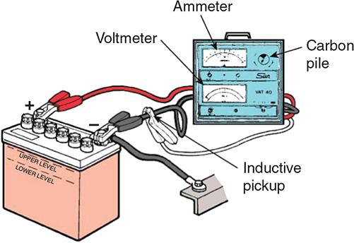
General Testing Procedures (2 of 4)
The output (load) test looks at the current output of the system.
A VAT can quickly check the amperage output. With the tester connected to the system, the engine is run at a moderate speed (2,500 rpm) and the carbon pile adjusted to obtain maximum current output.
This reading is compared against the rated output. Normally, readings that are more than 10 amps out of specifications indicate a problem, and the generator should be repaired or replaced.

Slide 35
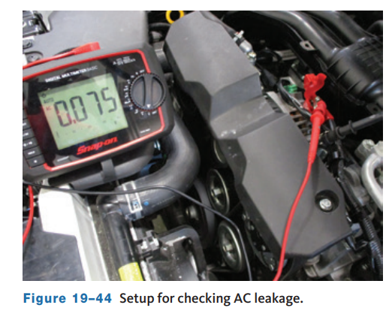
General Testing Procedures (3 of 4)
The output of a generator is highly dependent on the condition of the diodes.
Not only do the diodes rectify AC voltage to DC, they also prevent AC voltage from being present in the output.
Therefore, it is important to make sure that no AC is leaking into the charging system from the AC generator. Leakage typically occurs at a faulty diode.
Bad diodes are indicated by the presence of more than 0.050 AC volts on the output wire.
To check this, set the DMM to measure AC volts. Then connect the black meter lead to a good ground and the red lead to the generator’s battery terminal while the engine is running.
There should be no more than 50 millivolts AC. If there is more, check the diodes and/or replace the generator.

Slide 36
General Testing Procedures (4 of 4)
If charging voltage is incorrect or the system is not charging at all, first verify the power and ground circuits for the generator.
If power is present at the generator and the ground circuit voltage drop is acceptable, the control circuit should be inspected.
For computer-controlled charging systems, a scan tool is often required.
Begin by checking for any stored DTCs. If DTCs are stored for the charging system, you will need to follow the manufacturer’s service information to diagnose the DTC.
Locate the charging system PIDs and note the generator output command.
Increase the electrical load and engine rpm and note the commanded output and actual generator output.
Both should increase as electrical load increases.

Slide 37
Clutch Pulley Inspection
To check the pulley bearing, run the engine at 2,000 rpm and shut the engine off while at the increased speed.
A worn alternator drive pulley bearing will make noise for 5 to 10 seconds after the engine is shut down.
Special tools are sometimes required to check clutch-type pulleys.
To check the action of the overrunning clutch, rotate the pulley’s outer ring while keeping the center stationary.
The ring should rotate freely in the counterclockwise direction, and not rotate in the clockwise direction. If the pulley fails this check, replace it.
A torque wrench may be required to check the amount of force necessary to turn the pulley.
Refer to the manufacturer’s service information for testing procedures for the specific vehicle.

Slide 38
AC Generator Service
19.09 Explain how to replace an AC generator.
When the cause of charging system failure is the AC generator, it should be removed and replaced, or rebuilt.
Most late-model AC generators are not rebuilt. They are traded in as a core toward the purchase of a new or remanufactured unit.
When replacing a generator, ensure that you identify the correct replacement. Many vehicles have multiple generator options based on the engine and options installed.
Remember, improper connections to an AC generator can destroy it.
Some of the typical steps for removal:
  Begin by disconnecting the battery negative connection.
  Next, disconnect the wiring at the generator.
  Release the tension from the drive belt and remove the belt from the pulley.

Slide 39
Knowledge Check (2 of 2)
List some of the typical steps for removing an AC generator.

Slide 40
Knowledge Check Answer (2 of 2)
Typical steps:
  Begin by disconnecting the battery negative connection.
  Next, disconnect the wiring at the generator.
  Release the tension from the drive belt and remove the belt from the pulley.

Slide 41
Chapter Reflection
Please take a moment to compare your understanding of the charging system before and after you studied this chapter. Then respond to the following questions in one or two paragraphs. Use 150–200 words in your reflection.
Did you struggle to understand any aspects of the charging system theory and operation? What will you do to better understand these aspects?
Considering all you have learned, do you feel you are able to perform charging system service in a shop environment? What can you do to be more prepared?

